Slide 1

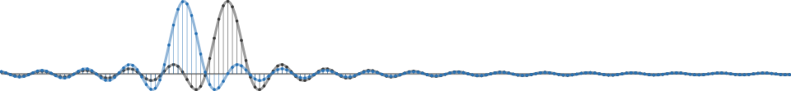
GNU Radio Workshop
Marcus Müller and Bastian Bloessl
July 2017 ▪ HAMRADIO ▪ SDR Academy ▪ Friedrichshafen, Germany

Slide 2
Master Plan
GNU Radio 101
Building an FM receiver
Using OOTs
Extending GNU Radio
Hands-On!

Slide 3
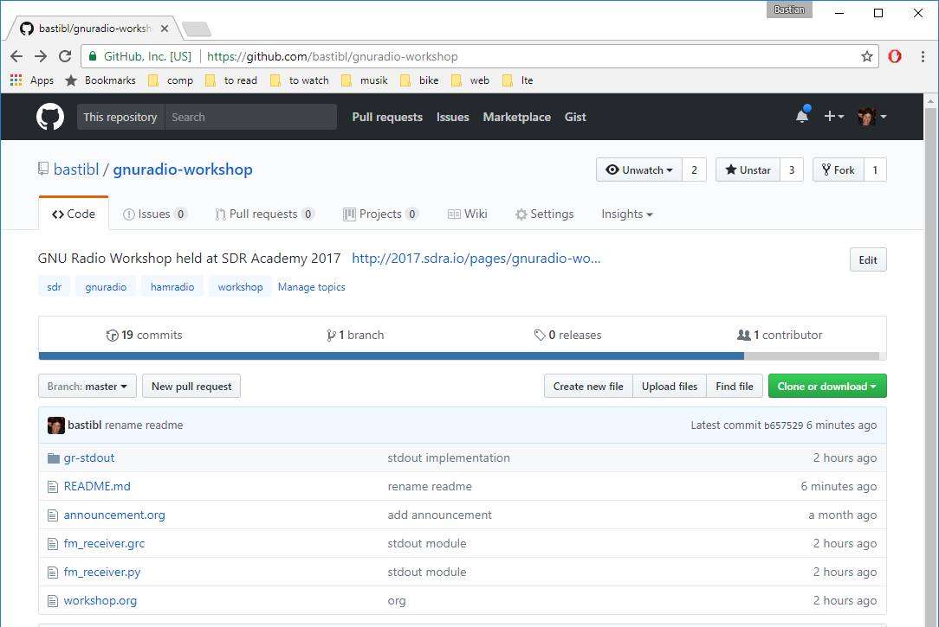
Material is Online
https://github.com/bastibl/gnuradio-workshop

Slide 4

About Us: Marcus Müller
Engineer @ Ettus Research
Research Assistant @ Communications Engineering Lab

Slide 5
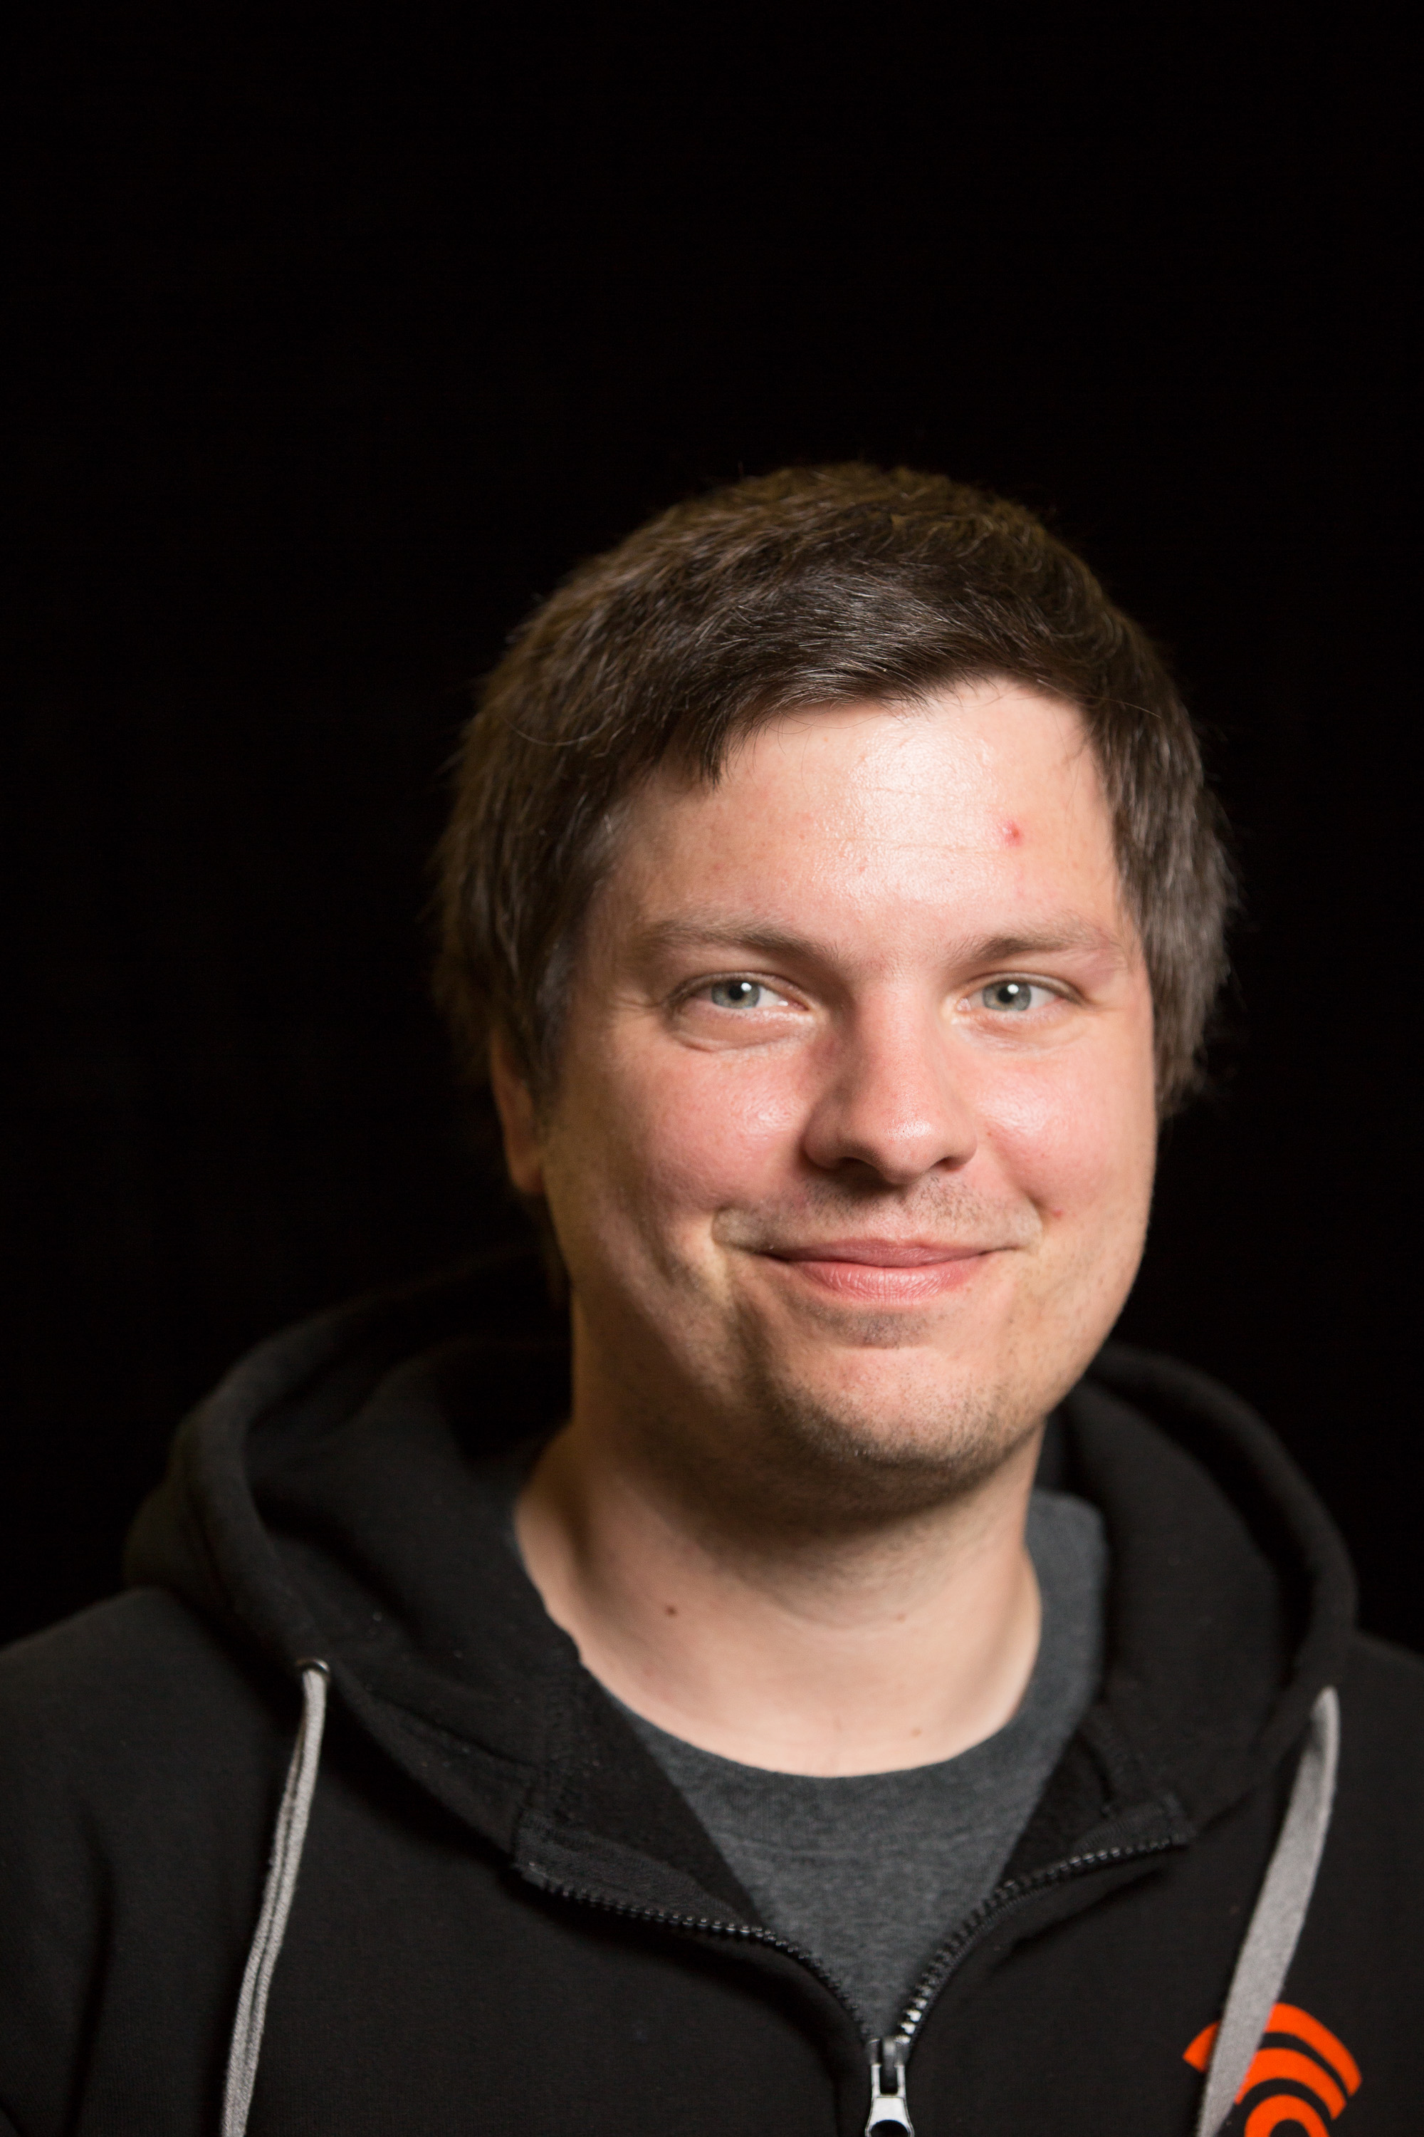


About Us: Bastian Bloessl
Researcher @ Connect Center Trinity College Dublin
Engineer @ SRS Software Radio Systems

Slide 6


GNU Radio is…
A signal processing library
Designed for real-time
The software part of an SDR
Not a radio application
The tool to build your own transceivers
Matches perfectly with the ham spirit

Slide 7
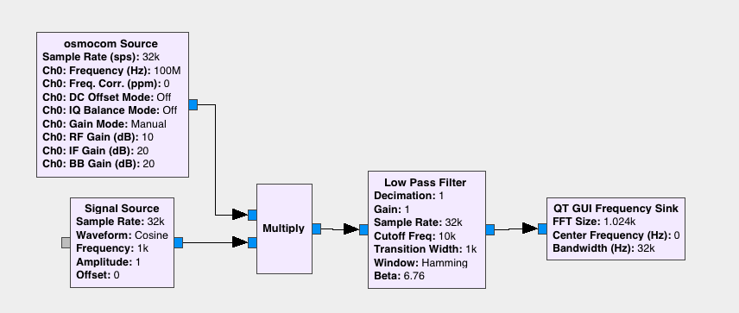
Basic Concept: Flow Graph
Transceivers are implemented as flow graphs
Similar to Simulink / schematics
Define structure and parameters of blocks

Slide 8
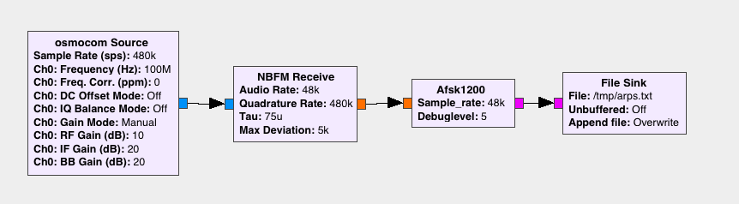
Basic Concept: Block
Written in C++ or Python
Implement one logical step
Can be encapsulated into hierarchical blocks

Slide 9
Data Streams
Samples are buffered
Data types are color-coded
Complex
Float
Byte

Slide 10
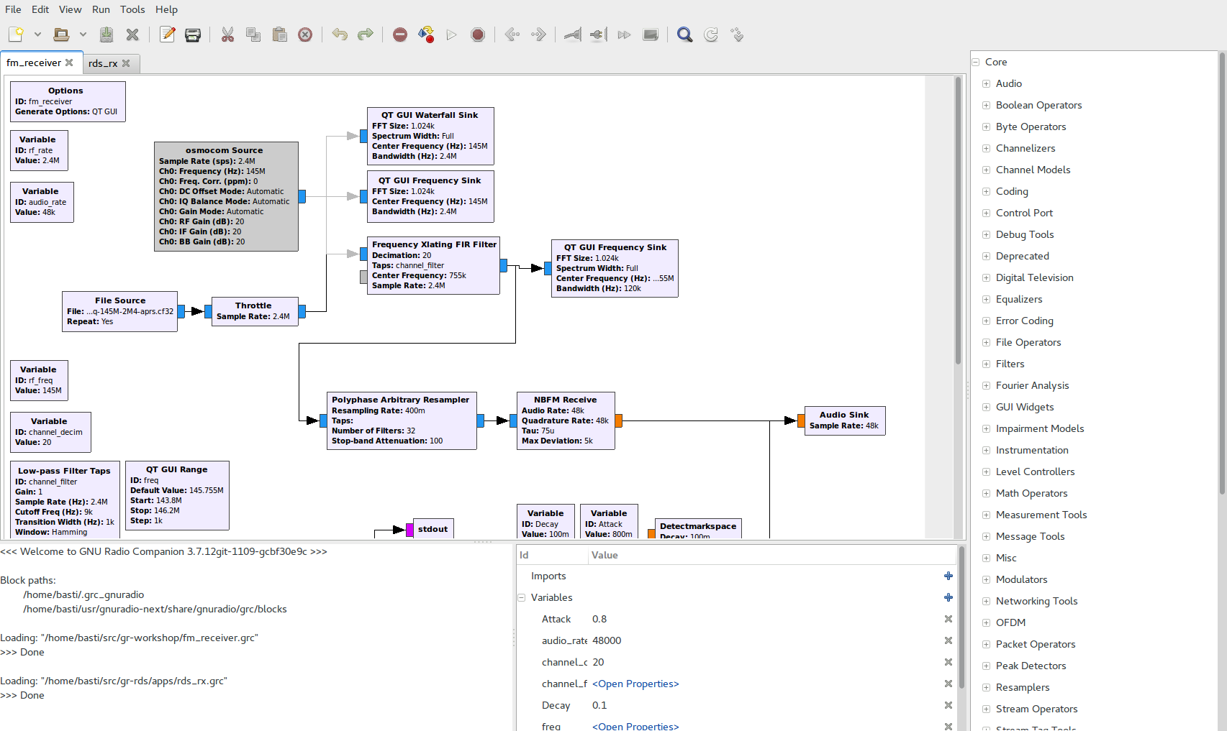
GNU Radio Companion
Block Library
Edit Flowgraph
Console
Variables

Slide 11
GUI Output and Instrumentation

Slide 12
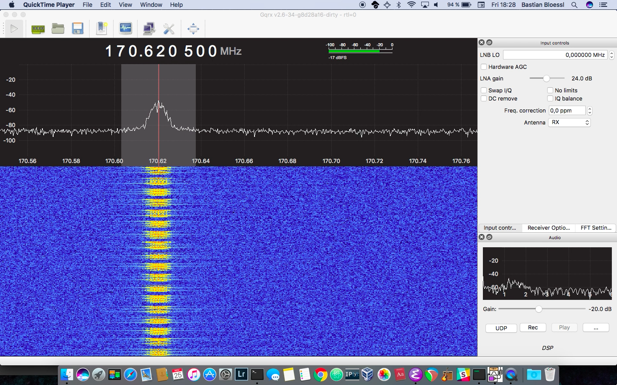
GQRX - a GNU Radio Application

Slide 13
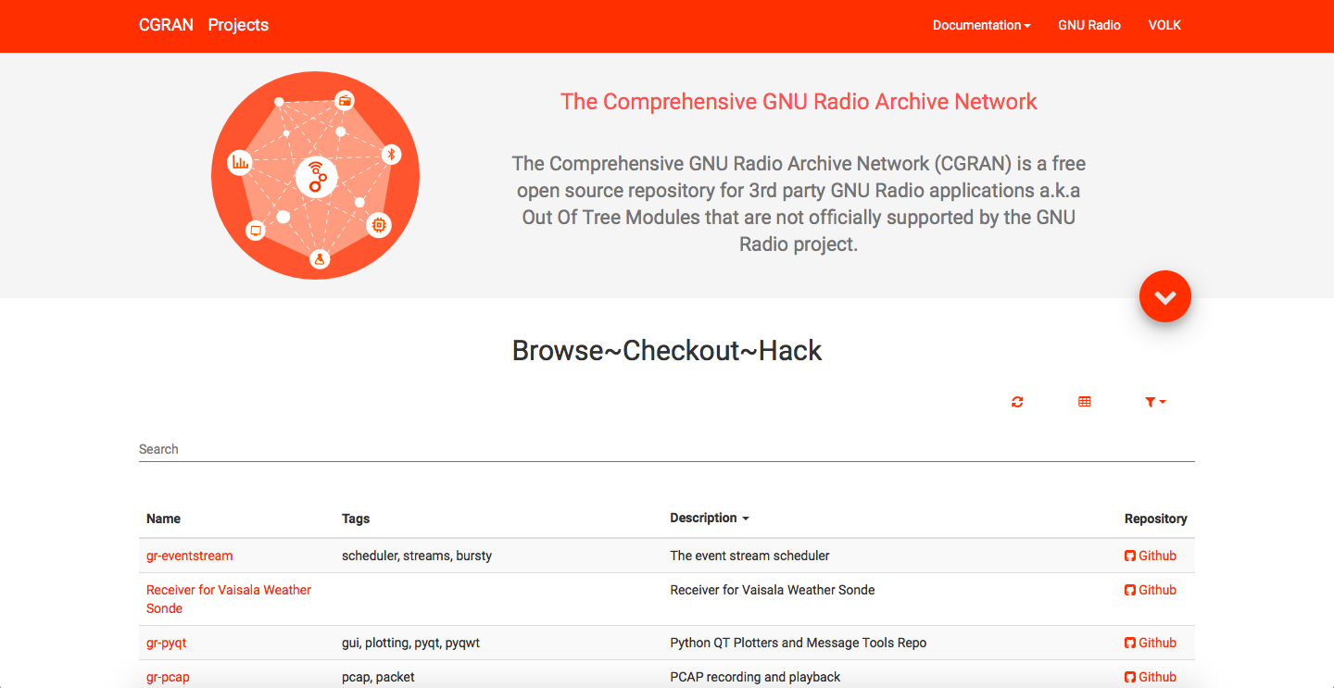
Out Of Tree Modules
GNU Radio can be extended with OOTs
OOTs cover more specific functionality
There is a large number available
CGRAN is our central database

Slide 14
GNU Radio is an Ecosystem
Active Open Source community
PyBombs, OOTs
GRCon
GNU Radio Foundation
FOSDEM SDR DevRoom
GSoC, SoCIS, R&S Competition, SDR Academy

Slide 15

GNU Radio is used by
Commercial
R&D
Defense
Research
Infosec
Research
Academic
Research
Hardware
Vendors
Professional
Service
Providers
Students
Hobbyists

Slide 16
Installing GNU Radio
From source: GitHub
Package manager
Some are pretty outdated
macOS / homebrew
PyBombs: integrated dependency management and 3rd party application installation

Slide 17
Learn // Discuss // Connect
Website: www.gnuradio.org
Development: github.com/gnuradio
Mailing List: discuss-gnuradio@gnu.org
Wiki: wiki.gnuradio.org
Slack: slack.gnuradio.org
Facebook: gnuradioproject
Twitter: @gnuradio

Slide 18




GNU Radio Workshop
Marcus Müller Bastian Bloessl
@dEnergy_dTime
www.bastibl.net
@bastibl.net

